Slide 1
CSCE 580
Artificial Intelligence
Ch.2 [P]: Agent Architectures and Hierarchical Control
Spring 2015
Marco Valtorta
mgv@cse.sc.edu

Slide 2
Acknowledgment
The slides are based on the textbook [P] and other sources, including other fine textbooks
  [AIMA-2]
  David Poole, Alan Mackworth, and Randy Goebel. Computational Intelligence: A Logical Approach. Oxford, 1998
  Ivan Bratko. Prolog Programming for Artificial Intelligence, Third Edition. Addison-Wesley, 2001
  George F. Luger. Artificial Intelligence: Structures and Strategies for Complex Problem Solving, Sixth Edition. Addison-Welsey, 2009
Notes:
From: David Poole [poole@cs.ubc.ca]
Sent: Wednesday, August 06, 2008 8:47 PM
To: Valtorta, Marco
Cc: Alan Mackworth
Subject: Re: New edition of your textbook
Hi Marco,
You can point the students to
http://www.cs.ubc.ca/~poole/aibook/

Slide 3
Building Situated Robots
Overview:
  Agents and Robots
  Robot systems and architectures
  Robot controllers
  Hierarchical controllers

Slide 4
Agents and Robots
A situated agent perceives, reasons, and acts in time in an environment
The manipulation of symbols to produce action is called reasoning.
An agent is something that acts in the world
A purposive agent prefers some states of the world to other states, and acts to try to achieve worlds they prefer
An embodied agent has a physical body
A robot is an artificial purposive embodied agent

Slide 5
What Makes an Agent?
Agents can have sensors and effectors (actuators) to interact with the environment
Agents have (limited) memory and (limited) computational capabilities
Agents reason and act in time

Slide 6
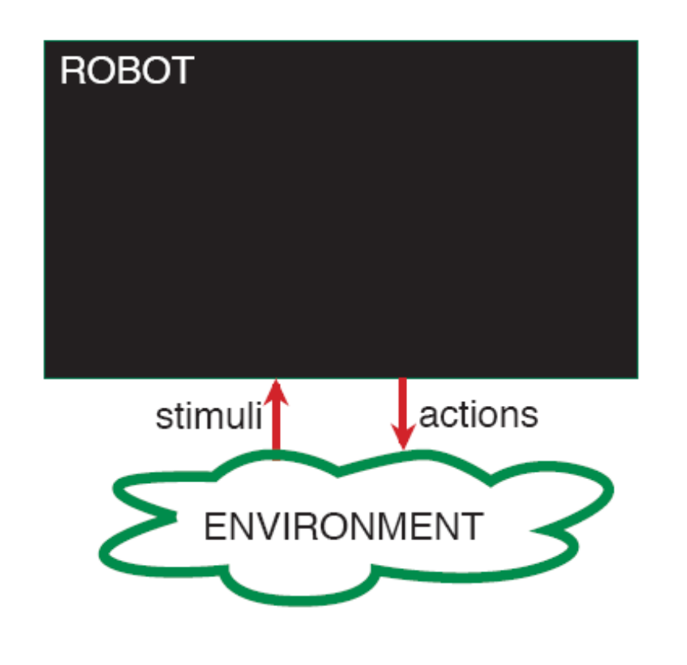
Robotic Systems
A robotic system is made up of a robot and an environment
  A robot receives stimuli from the environment
  A robot carries out actions in the environment

Slide 7
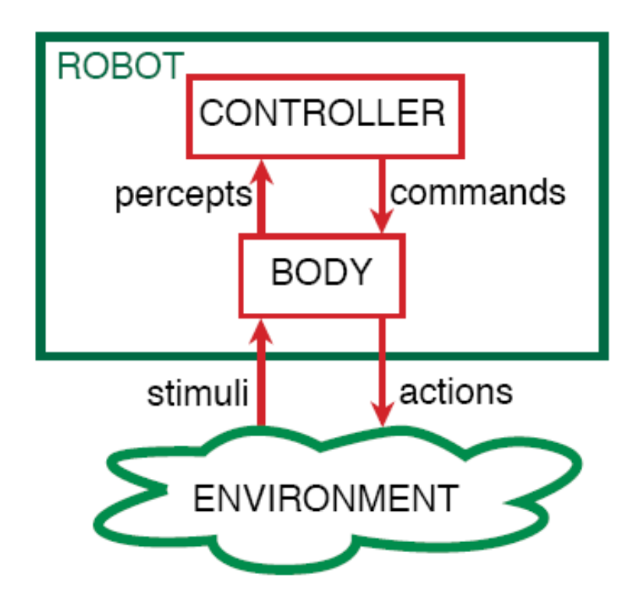
Robotic System Architecture
A robot is made up of a body and a controller
A robot interacts with the environment through its body
The body is made up of:
  sensors that interpret stimuli
  actuators that carry out actions
The controller receives percepts from the body
The controller sends commands to the body
The body can also have reactions that are not controlled

Slide 8
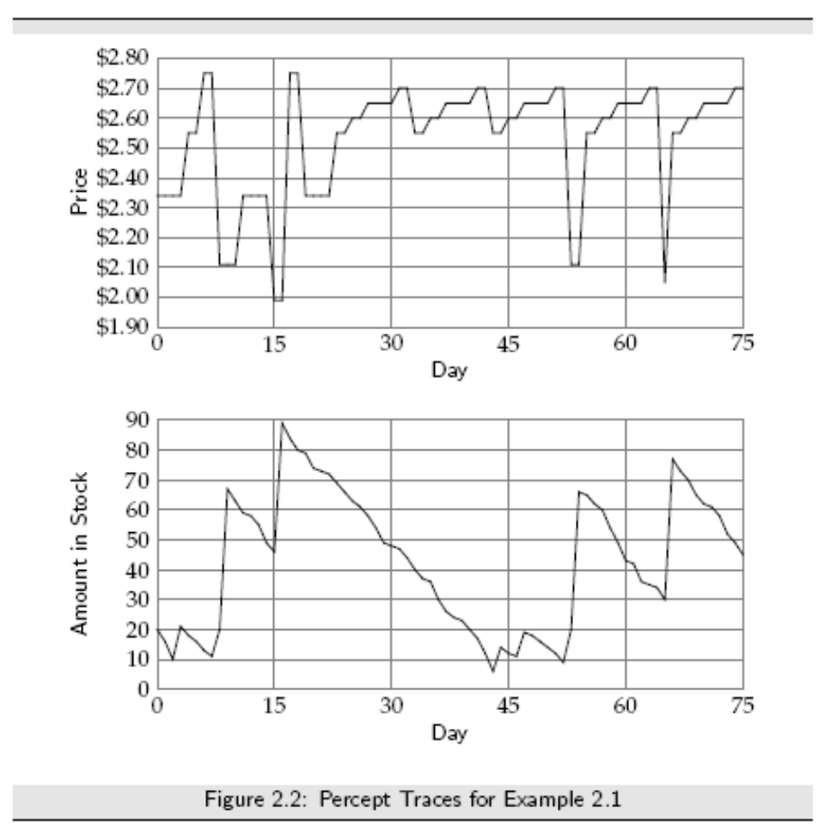
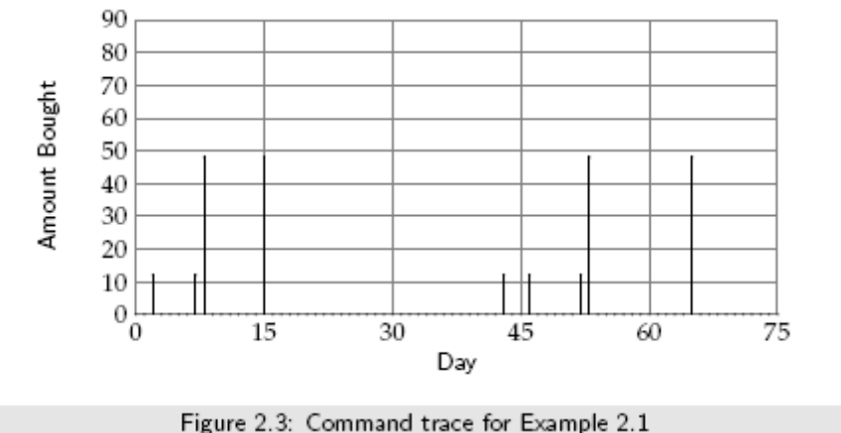
Percept and Command Traces for a Trading Agent

Slide 9
Implementing a Controller
A controller is the brains of the robot
Agents are situated in time, they receive sensory data in time, and do actions in time
The controller specifies the command at every time
The command at any time can depend on the current and previous percepts

Slide 10
The Agent Functions
Let T be the set of time points
A percept trace is a function from T into P, where P is the set of all possible percepts
A command trace is a function from T into C, where C is the set of all commands
A transduction is a function from percept traces into command traces that's causal: the command trace up to time t depends only on percepts up to t
A controller is an implementation of a transduction

Slide 11
Belief States
A transduction specifies a function from an agent's history at time t into its action at time t
An agent doesn't have access to its entire history. It only has access to what it has remembered
The internal state or belief state of an agent at time t encodes all of the agent's history that it has access to
The belief state of an agent encapsulates the information about its past that it can use for current and future actions

Slide 12
Functions Implemented in a Controller
For discrete time, a controller implements:
  a belief state transition function remember : SxP->S, where S is the set of belief states and P is the set of possible percepts
    s_{t+1} = remember (s_{t}, p_{t}) means that s_{t+1} is the belief state following belief state s_{t} when p_{t} is observed
  A command function do : SxP->C, where S is the set of belief states, P is the set of possible percepts, and C is the set of possible commands.
    c_{t} = do(s_{t,} p_{t}) means that the controller issues command c_{t} when the belief state is s_{t} and p_{t} is observed

Slide 13

Robot Architectures
You don't need to implement an intelligent agent as:
as three independent modules, each feeding into the next.
It's too slow.
High-level strategic reasoning takes more time than the reaction time needed to avoid obstacles.
The output of the perception depends on what you will do with it

Slide 14
Hierarchical Control
A better architecture is a hierarchy of controllers.
Each controller sees the controllers below it as a virtual body from which it gets percepts and sends commands.
The lower-level controllers can
  run much faster, and react to the world more quickly
  deliver a simpler view of the world to the higher-level controllers

Slide 15
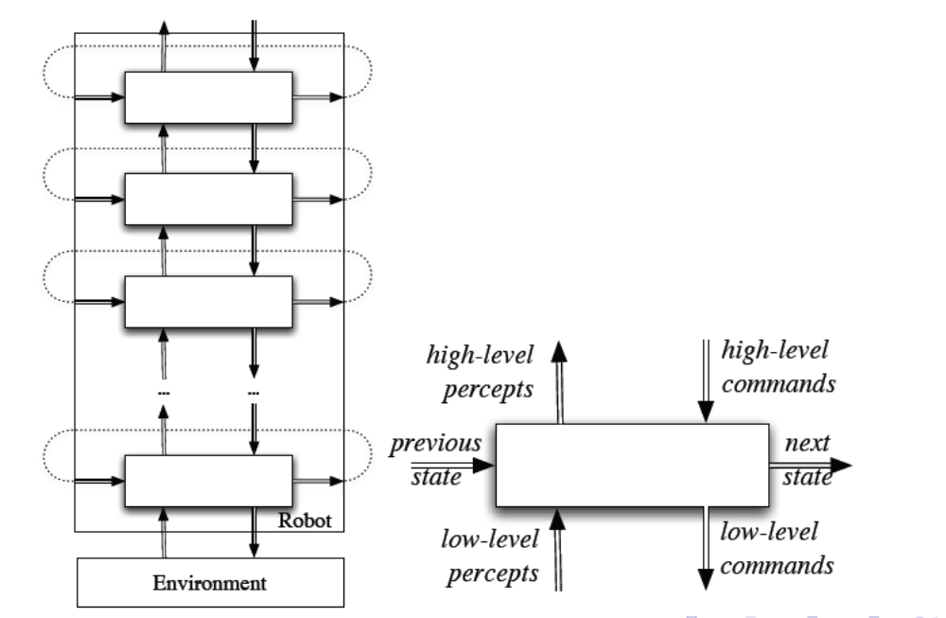
Hierarchical Robotic System Architecture

Slide 16
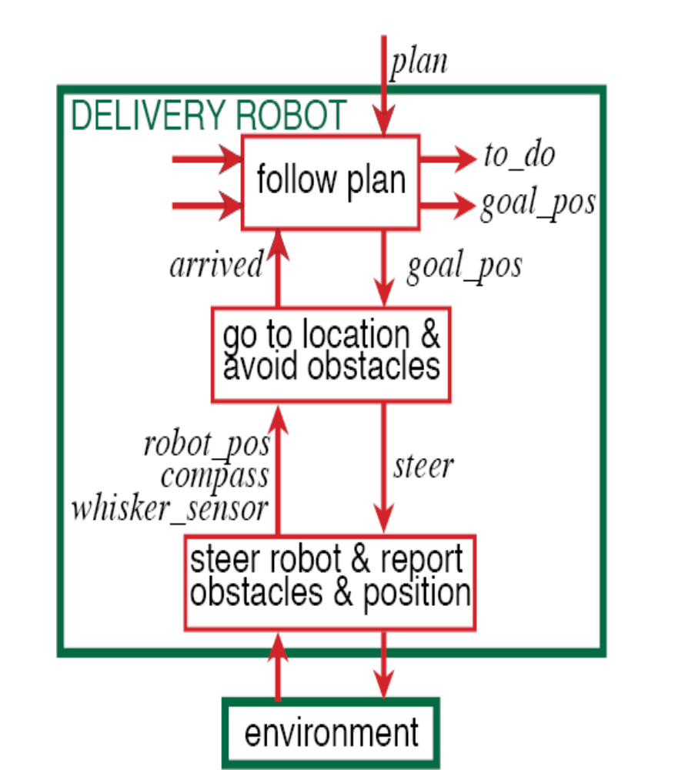
A Decomposition of the Delivery Robot
The robot has three actions: go straight, go right, go left. (Its velocity doesn't change)
It can be given a plan consisting of sequence of named locations for the robot to go to in turn
The robot must avoid obstacles
It has a single whisker sensor pointing forward and to the right. The robot can detect if the whisker hits an object. The robot knows where it is
The obstacles and locations can be moved dynamically. Obstacles and new locations can be created dynamically

Slide 17
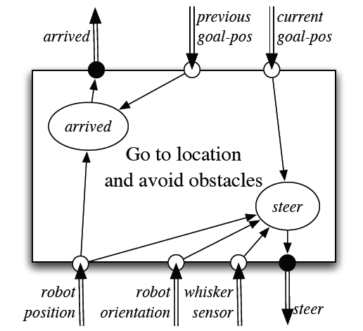
Middle Layer of the Delivery Robot
if whisker_sensor = on
then steer := left
else if straight_ahead(robot_pos, robot_dir, current_goal_pos)
then steer := straight
else if left_of (robot_position, robot_dir, current_goal_pos)
then steer := left
else steer := right
arrived := distance(previous_goal_pos; robot_pos) < threshold
Notes:
[P] uses “target” instead of “goal.”

Slide 18
Top Layer of the Delivery Robot
The top layer is given a plan which is a sequence of named locations
The top layer tells the middle layer the goal position of the current location
It has to remember the current goal position and the locations still to visit
When the middle layer reports the robot has arrived, the top layer takes the next location from the list of positions to visit, and there is a new goal position

Slide 19
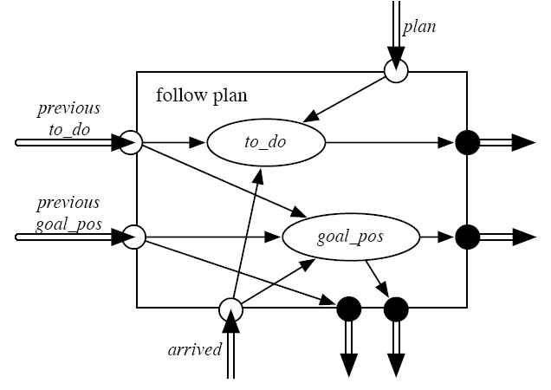
Top Layer
The top layer has two belief state variables. The value of the variable to_do is the list of all pending locations. The variable goal_pos maintains the goal position
if arrived and not empty(to_do)
then
goal_pos’ := coordinates(head(to_do))
  to_do’ := tail(to_do)
  end if
Here to_do’ is the next value for the to_do feature
Notes:
Again, [P] uses “target” instead of “goal.” In this layer, if the to_do list becomes empty, the robot does not change its target position. It keeps going around in circles. (See p.57 [P]).

Slide 20
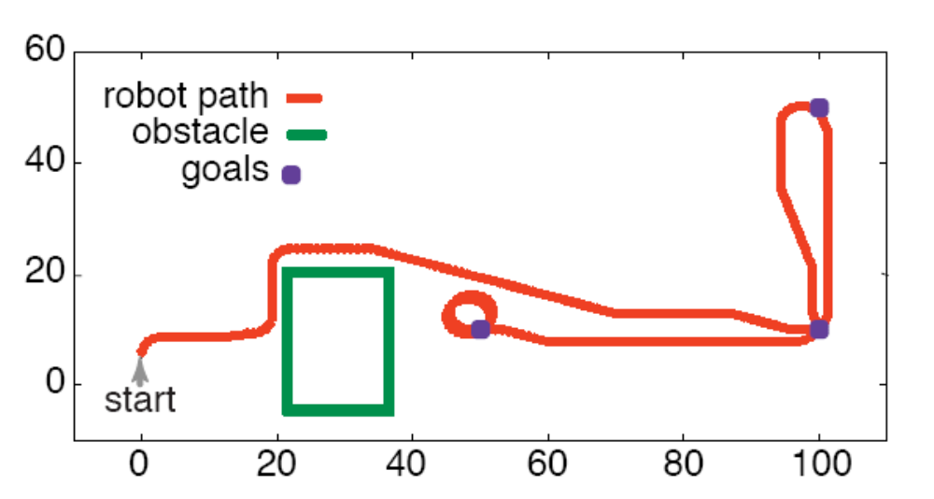
Simulation of the Robot
assign(to_do, [goto(o109), goto(storage), goto(o109), goto(o103)], 0).
arrived(1).
Notes:
This top-level plan refers to a layout similar to that of Figure 1.7 (p.32 [P]). o109 and o103 are r109 and r103 in the figure; storage is r117. The second clause (arrived(1)) is there for technical reasons. This is (more or less) the “Chapter 12 Example” in the Robot Applet Version 4.6 at aispace.org. Remind that you may have to configure java to allow the applets at http://www.aispace.org and at http://aispace.org to run, because they are self-signed applications. See the tutorial at http://www.java.com/en/download/help/java_blocked.xml for details.

Slide 21
Belief States
An agent decides what to do based on its belief state and what it observes.
A purely reactive agent doesn't have a belief state.
A dead reckoning agent doesn't perceive the world.
  neither work very well in complicated domains.
It is often useful for the agent's belief state to be a model of the world (itself and the environment)
It is often useful to model both the noise of forward prediction and sensor noise---then Bayesian filtering is appropriate
Notes:
Section 2.3.1 [P]

Slide 22
Acting with Reasoning
Knowledge
  In philosophy: true, justified belief
  In AI:
    knowledge is information about a domain that can be used to solve problems in that domain
    belief is information about the current state

Slide 23
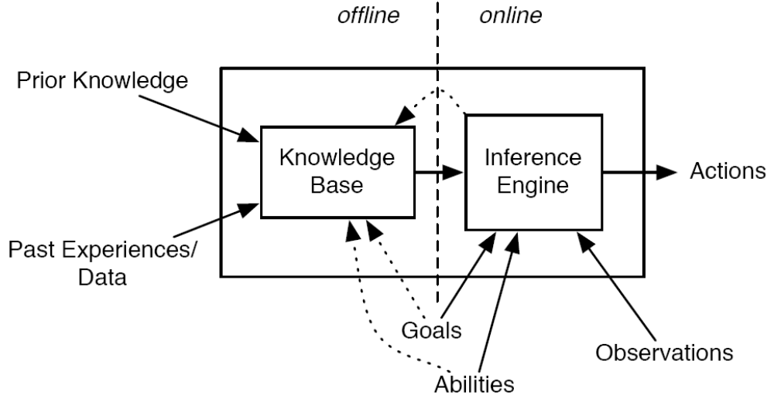
Offline and Online Decomposition
Expert systems: lots of prior knowledge
Machine learning: lots of data
Notes:
…of an agent (Fig. 2.9 [P])
Traditional distinction: ES vs. ML

Slide 24
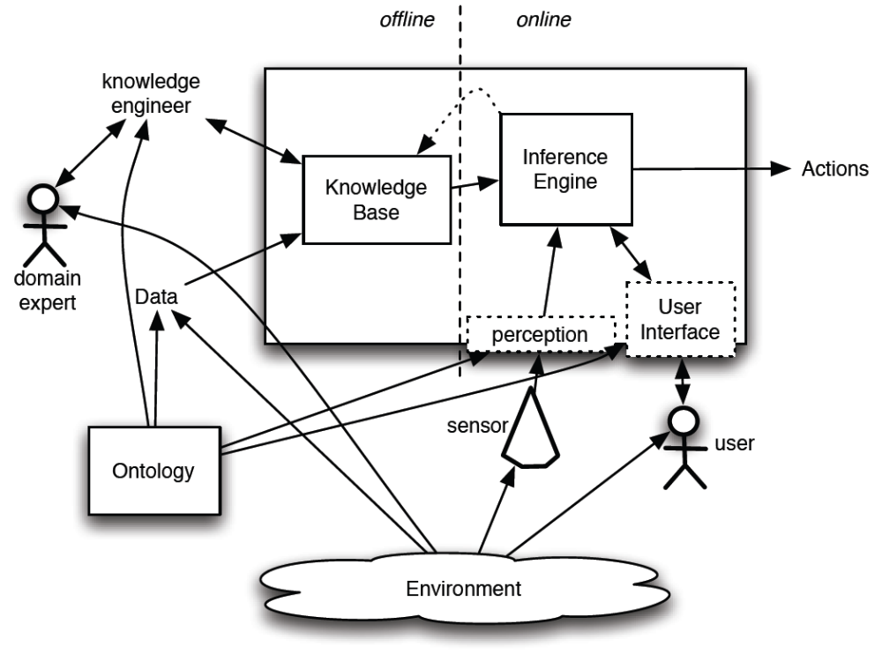
Roles in an Intelligent Agent
An ontology is the specification of the meaning of the symbols used in an information system
Notes:
Section 2.5.1 [P]

Slide 25
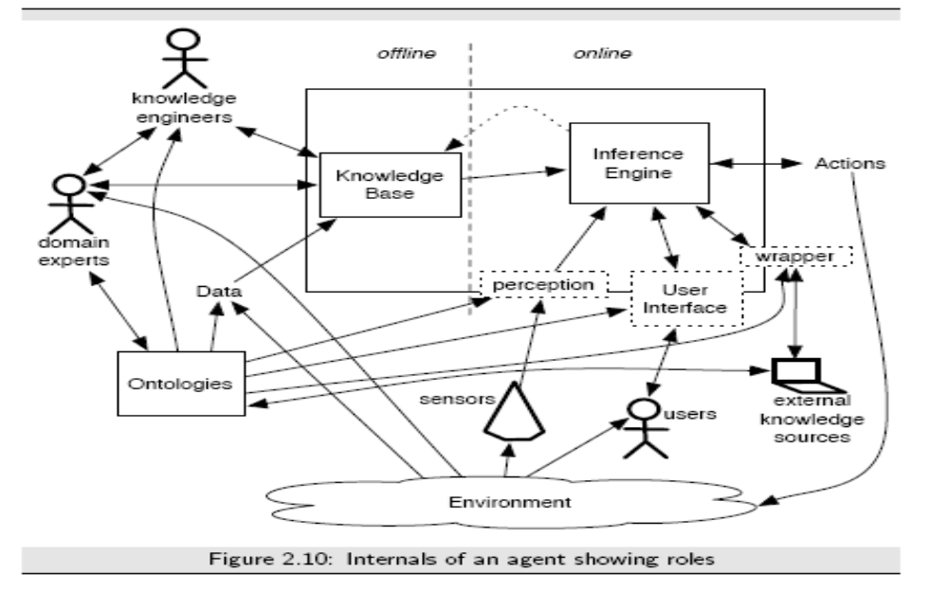
Roles in an Intelligent Agent
Notes:
Section 2.5.1 [P]. More detailed version of previous slide

